Slide 1
HR ANALYTICS
TAINGUYEN-MEUMOC
MENTORSHIP_PROGRAM

Slide 2
AGENDA
I. OUTLINE
II. ANALYSIS

Slide 3
I. AGENDA
1. Fact_Employee
4. Fact_LeaveDay
2. Fact_Diversity
5. Fact_Termination
3. Fact_Hiring

Slide 4
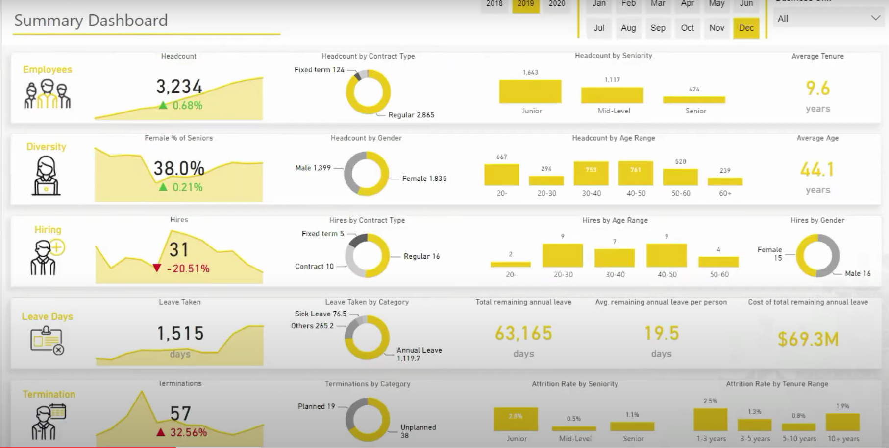
1. Fact_Employee

Slide 5
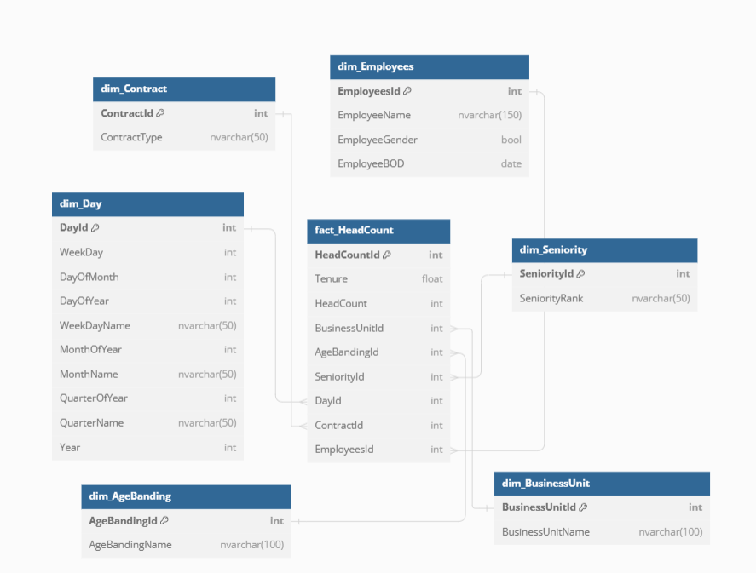
1. Fact_Employee

Slide 6
2. Fact_Diversity

Slide 7
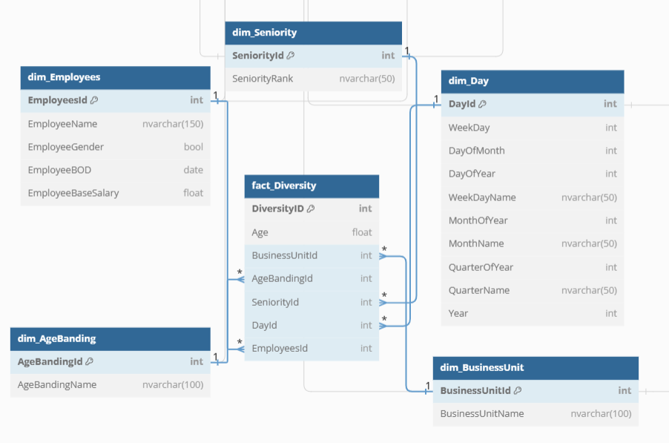
2. Fact_Diversity

Slide 8
3. Fact_Hiring

Slide 9
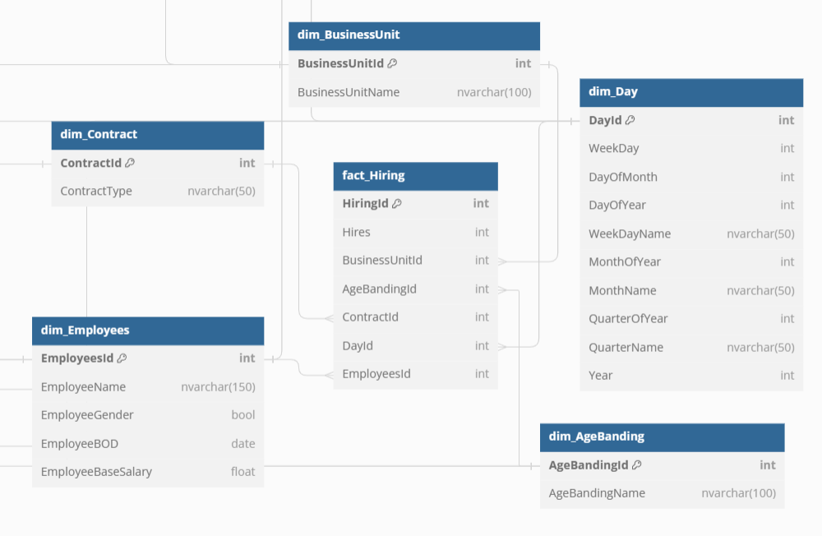
3. Fact_Hiring

Slide 10
4. Fact_LeaveDay

Slide 11
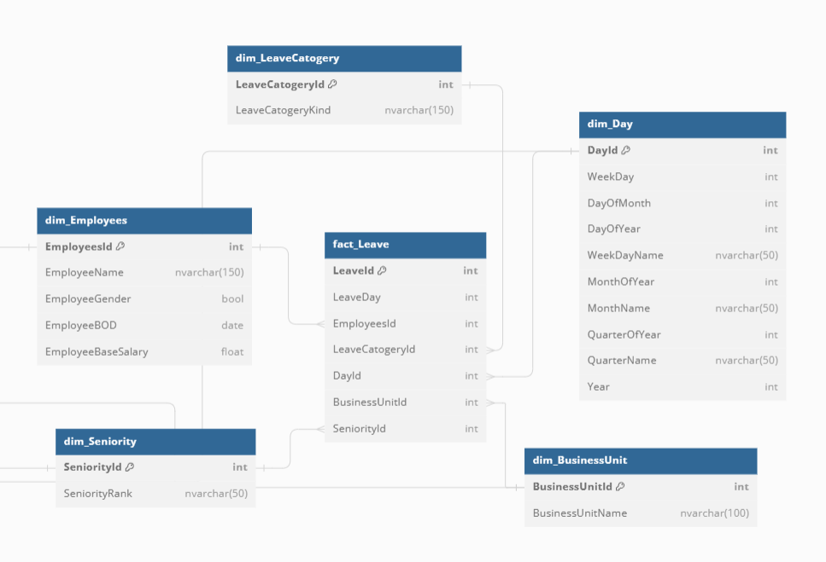
4. Fact_LeaveDay

Slide 12
5. Fact_Termination

Slide 13
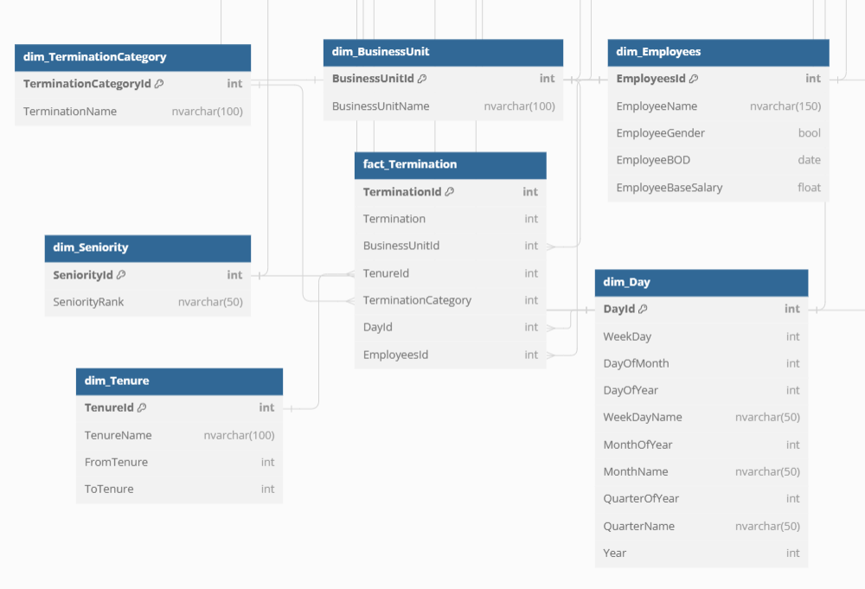
5. Fact_Termination

Slide 14


THANKS FOR READING

